Slide 1
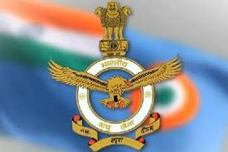
Presentation on:
Indian Air force
A cut Above

Slide 2
History and Birth:
Founded: 8 October 1932; (86 years ago)
Role :Aerial warfare
Size:139,576 active personnel
Arms around: 1,720+ aircraft
Part of Indian Armed Forces
Headquarters: New Delhi

Slide 3
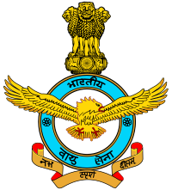
Commands spread over:
Eastern Command: Shillong
Central Command: Allahabad
South Western Command: Jodhpur
Southern Command: Thiruvananthapuram
Training Command: Bangalore
Maintenance Command: Nagpur
Western Command: New Delhi

Slide 4
Some Aircrafts Includes:
Mirage-2000
HAL Tejas LCA
Mikoyan MiG-21
Sukhoi Su-30MKI
Mikoyan MiG-27
SEPECAT Jaguar

Slide 5
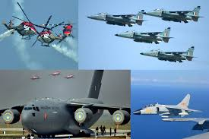
Types of Air Crafts in IAF

Slide 6
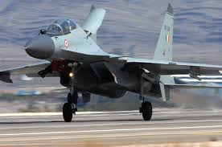
Fighter Plane:
SUKHOI SU-30
Sukhoi Su-30MKM. The Sukhoi Su-30 (Russian: Сухой Су-30; NATO reporting name: Flanker-C) is a twin-engine, two-seat super maneuverable fighter aircraft developed by Russia's Sukhoi Aviation Corporation. It is a multirole fighter for all-weather, air-to-air and air-to-surface deep interdiction missions.

Slide 7
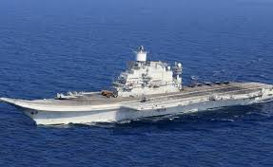
Air craft carrier:
INS Vikramaditya
INS Vikramaditya, which refers to one having valor like the Sun, is a former USSR carrier vessel and entered into service with the Indian Navy in 2013. Launched in the early 1980s, the carrier, which was originally named as Baku, served the Soviet Navy from 1987 to 1991.

Slide 8
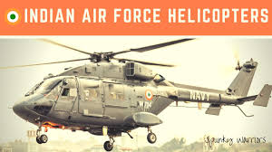
Helicopters : MIL MI-24
The Mil Mi-24 is a large helicopter gunship, attack helicopter and low-capacity troop transport . Currently, nine Mi-35 attack helicopters are operated by the ANAAC. The Mil Mi-24 is a large helicopter gunship, attack helicopter and low-capacity troop transport . Currently, nine Mi-35 attack helicopters are operated by the ANAAC.

Slide 9
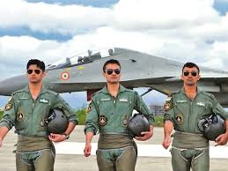
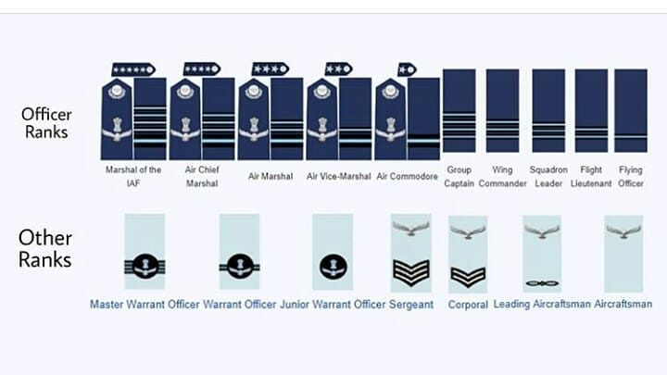
Hierarchy of IAF:
Commissioned ranks
Marshal of the Air force
Air Chief Marshal
Air Marshal
Air Vice Marshal
Air Commodore
Group Captain
Wing Commander
Squadron Leader
Flight Lieutenant
Flying Officer
Non-Commissioned ranks
Master Warrant Officer
Warrant Officer
Junior Warrant Officer
Sergeant
Corporal
Leading Aircraftmen
Aircraftsmen

Slide 10
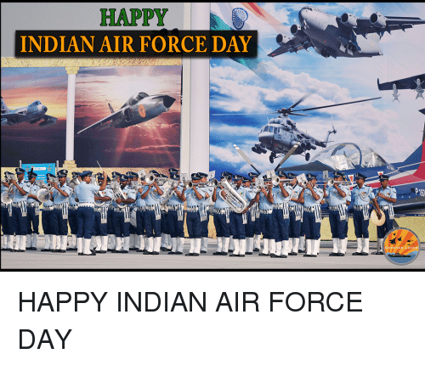
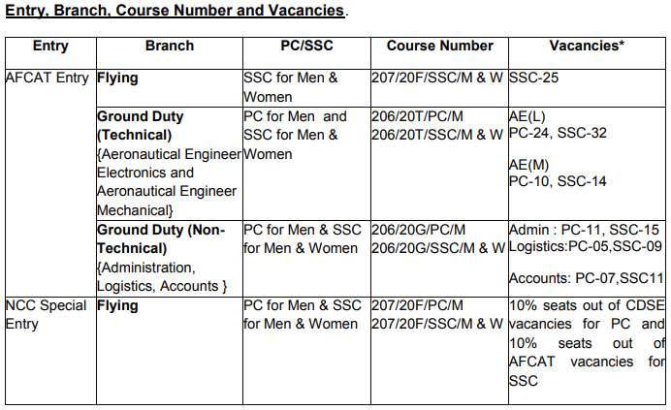
Guardians of the sky
A Carrier to opt

Slide 11
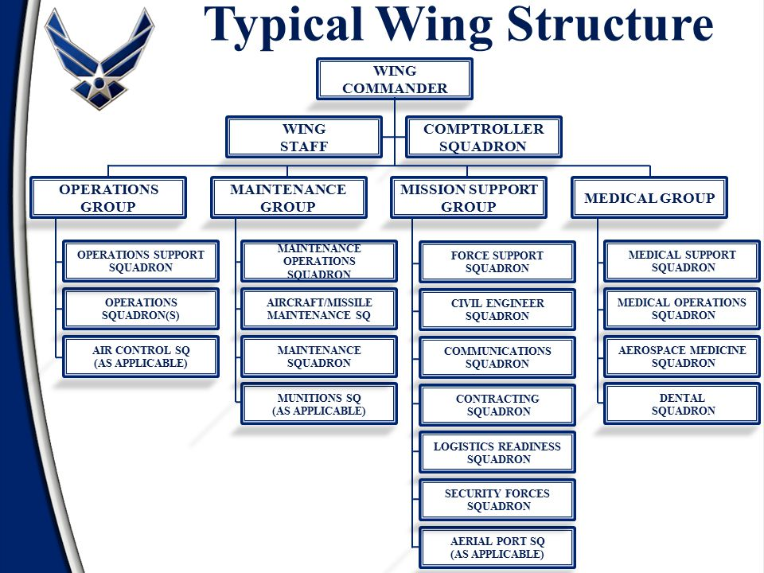
Wing Structure:

Slide 12
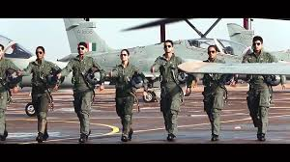

INSPIRING QUOTES:
CAPT. SUBRAMANIUM
CAPT.VIKRAM BATRA
YOU HAVE NEVER LIVED UNTIL YOU HAVE ALMOST DIED, AND FOR THOSE WHO CHOOSE TO FIGHT- LIFE HAS A SPECIAL FLAVOR.THE PROTECTED WILL NEVER KNOW
BEFORE I PROVE MY BLOOD IF MY DEATH COMES I’LL SURELY KILL MY DEATH

